Slide 1
Detecting suicidal ideation in reddit posts using nlP and machine learning
Mohd Kushaad
DS1-34
2023889
Under Guidance of
Mr. Gulshan Dhasmana
Assistant Professor

Slide 2
Problem Statement
As Reddit users increasingly express distress and suicidal thoughts through their posts, detecting these signs is crucial. Manual moderation is insufficient due to the high volume of content, and delays in identifying at-risk individuals can have serious consequences. This project aims to develop a machine learning model using Natural Language Processing (NLP) to automatically detect suicidal ideation in Reddit posts.

Slide 3
Introduction
Over 16 million people attempt suicide worldwide
Since each day more people are starting to use the internet, and social media specifically, it has emerged as a new platform to provide data for those who are at risk of suicide and a means of possible early intervention.
Hence, building a project that would automatically determine suicidal ideation through sentiments expressed by users online provides an efficient solution in preventing suicides.
The project is based on training a Machine Learning model using Reddit database.
The trained model is tested and evaluated.

Slide 4







Methodology
Keywords​
Data Collection​
Data Annotation​
Keywords relevant to the dataset
Dataset based on the keywords is collected
Data is annotated based on the classifications
Performance Evaluation
Model Training
Data Preprocessing
The trained model is evaluated based on certain parameters
Model is trained based on the method used.
Data is processed to make it suitable for training.

Slide 5
Data collection and preprocessing
Dataset was collected from r/SuicideWatch, r/depression and r/teenagers subreddits on Reddit. It was obtained from Kaggle.com.
Special characters, emojis, numbers and any objects than the alphabets were removed.
Lemmatization (converting words into their roots), Tokenization (breaking text into smaller chunks for better processing) and Vectorization (converting words or tokens into machine readable form) were done to the preprocessed dataset.
The processed data was then split in 80-20 parts for training and testing, respectively.
Model training and testing
Logistic Regression method was used because of its simplicity and efficiency to work well on medium-size datasets.
The model was trained on 80% of dataset and saved for future accessibility and implementation.
After training it was tested on rest of the 20% dataset. The predicted output was then evaluated based on accuracy, precision and other classifications.

Slide 6
Results and discussion
Accuracy
F1 score
The overall accuracy of the model tested on dataset of 40k+ entries was 93.01%.
The harmonic mean of precision and recall, or F1 Score turned out to be 93.
Precision
Recall
The precision of the tested model turned out to be 93% on average.
The true positive rate or Recall for the model was turned out to be 93% on average.

Slide 7
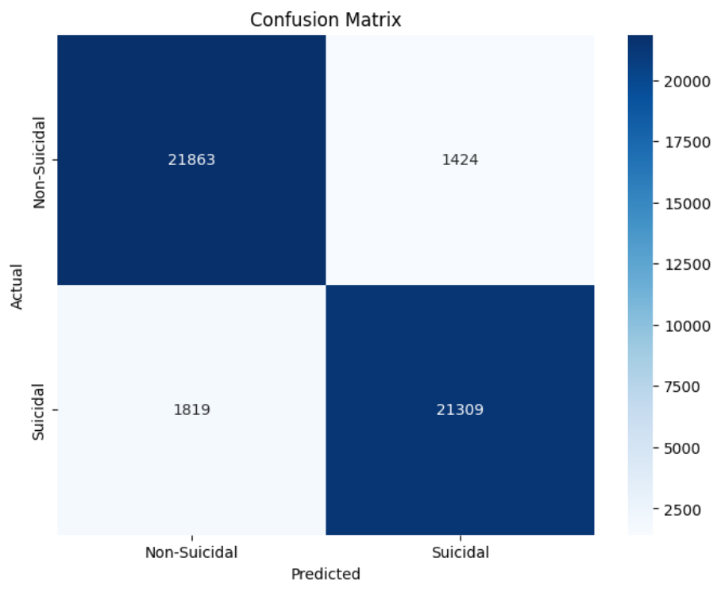
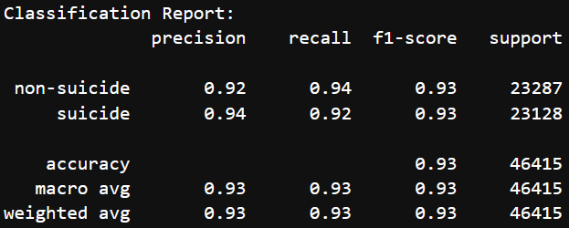
Evaluation and classification report

Slide 8
The overall performance of the model was satisfactory, in context of the classification report and evaluation.
F1 score indicates that not many false negatives i.e., missed suicides and false positives i.e., mislabeling non-suicides cases were present.
When the model was tested with real time data, it performed well with long and detailed sentences.
However, the model messes up badly when given words like “live” or sentences like “I want to live”.
This is majorly because Logistic Regression can’t understand nuances of language and different meaning of the same words. And since some positive words like ‘live’ usually have more occurrences in suicidal posts, the model weights it more towards the suicide label.
Logistic Regression and the TF-IDF vectorizer don’t understand meanings of words and remove important words like ‘not’ during preprocessing, leading to such results.

Slide 9
Conclusion
As ever-increasing userbase of the internet express themselves online, it gives new opportunities to help those in need.
The aim of the project was to make a model that could efficiently and accurately identify suicidal ideation through posts shared by users.
Evaluated scores of the model were good on paper but the model is far from being used in real time. Different methods are to be used to make the model more accurate to real time data.
future work
More classifications based on emotions can be added like sad, depressed, etc. for making the predictions more precise.
The model, after much refining can be implemented on Reddit itself, for flagging down potential posts and helping the user.
Since the model takes data in general, we can train it for different social media platforms and implement the model on those platforms, helping the users web-wide.

Slide 10
Thank you
Mohd Kushaad​​

